Slide 1
ICT Programming Lesson 5:
Working with Functions and Events

Slide 2
Objectives
4.3.2: Define the three main programming control structures used in structured programming: sequential, selection (decision), and iteration (loops).
4.4.4: Create animated objects using a high-level programming environment (e.g., Alice, Greenfoot) to control their behavior.
4.4.5: Create a simple program that uses animated objects.
4.4.8: Troubleshoot and debug errors in code.

Slide 3
Functions
Like a mini program within a program that you can use over and over
Functions are named units of code that perform a task or cause an action to take place.
A function is called upon or executed by its name.
Many programming languages contain several built-in functions that save programmers

Slide 4
Argument
A value that is passed to a routine

Slide 5
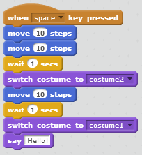
Event
An action that takes place while a program is running, such as clicking a mouse or pressing a key

Slide 6
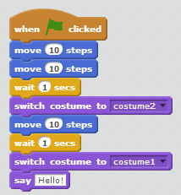
Event Handler
The code that is executed when the event occurs

